Slide 1
West Sussex COVID-19 Data Summary
This pack brings together information relating to COVID-19 in West Sussex. West Sussex County Council Public Health Department monitors information on a daily basis and produce this summary pack as well as showing more detailed analysis on the following website: https://wsx-c19-weekly-supplement.netlify.app. Links are provided to the public data sources available and a summary of current sources is provided at the end of this pack. Local authorities have access to some information that is not in the public domain, this may be due to small numbers or data being provisional.
Contact
publichealth@westsussex.gov.uk
Slide 1

Slide 2
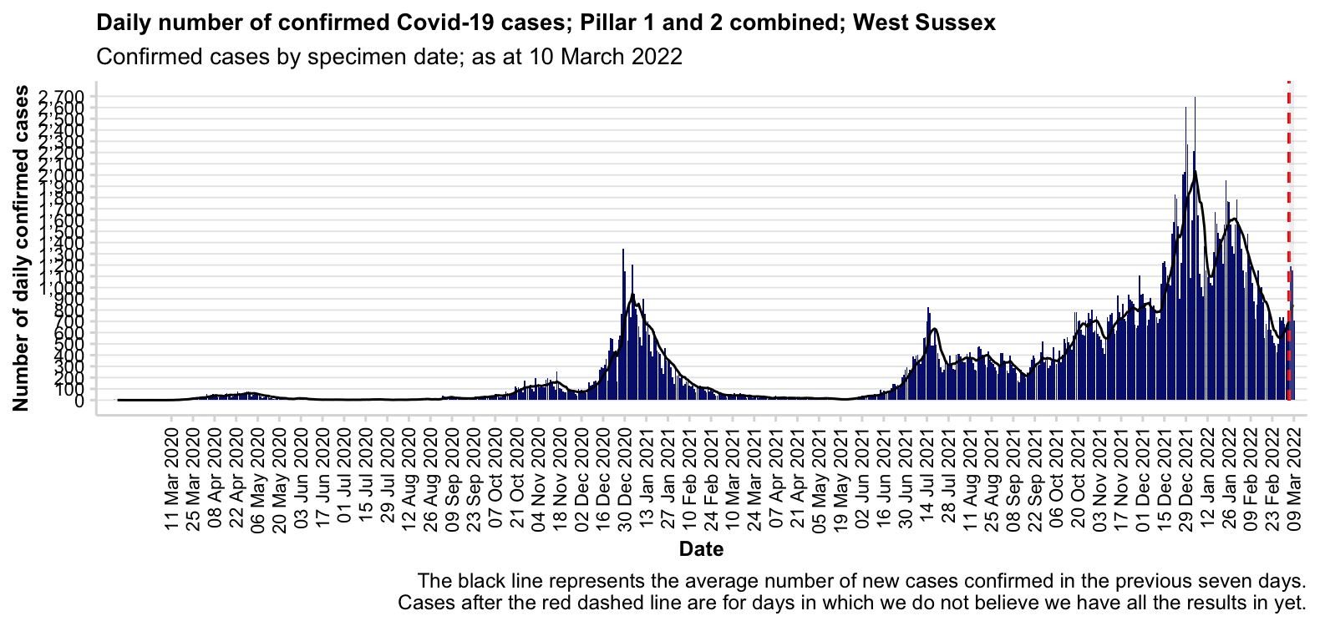
Source: https://coronavirus.data.gov.uk/
Slide 2

Slide 3
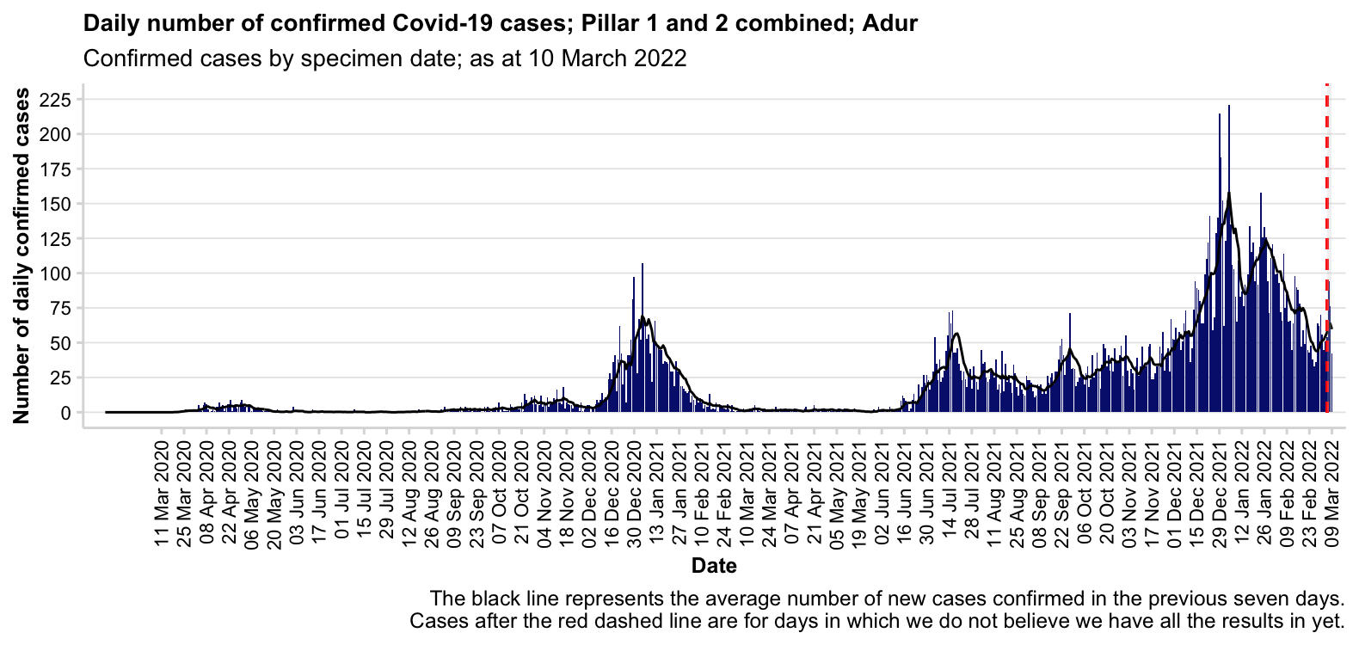
Source: https://coronavirus.data.gov.uk/
Slide 3

Slide 4
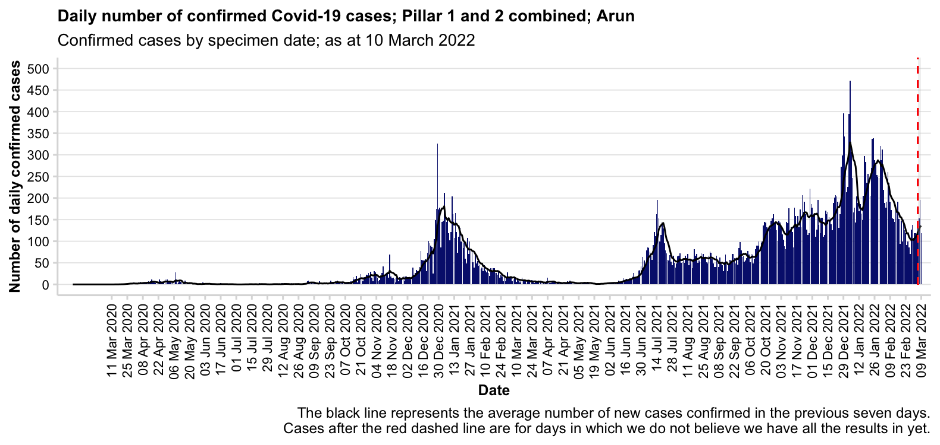
Source: https://coronavirus.data.gov.uk/
Slide 4

Slide 5
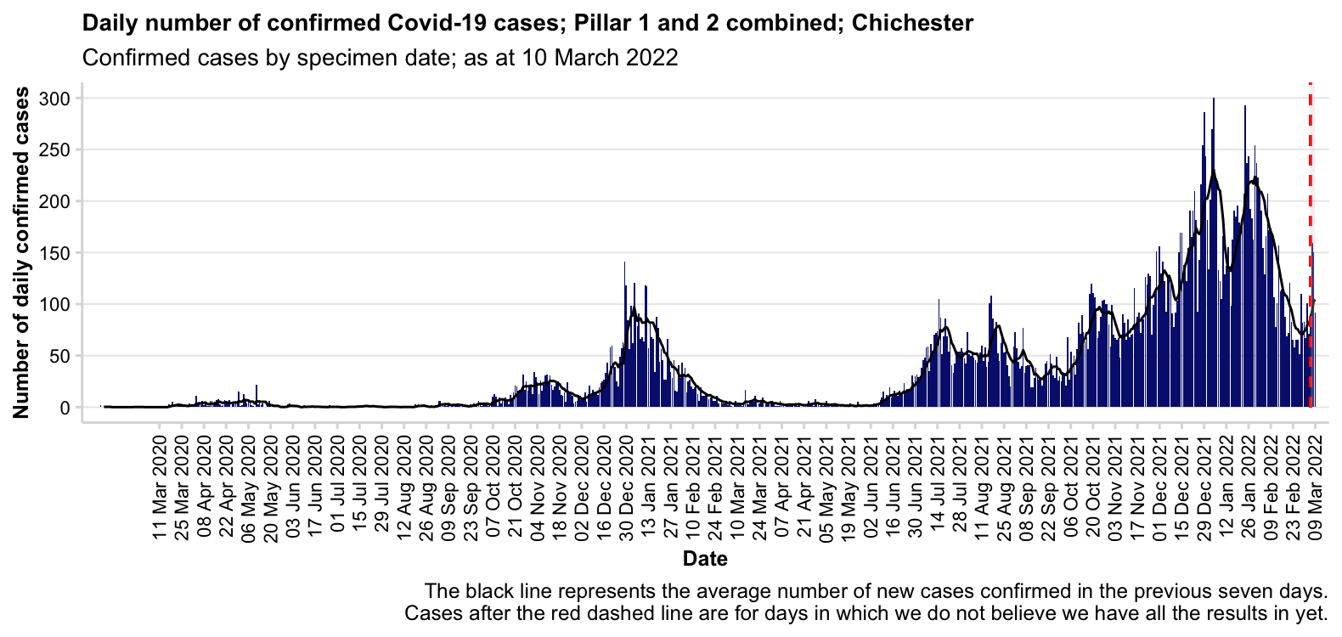
Source: https://coronavirus.data.gov.uk/
Slide 5

Slide 6
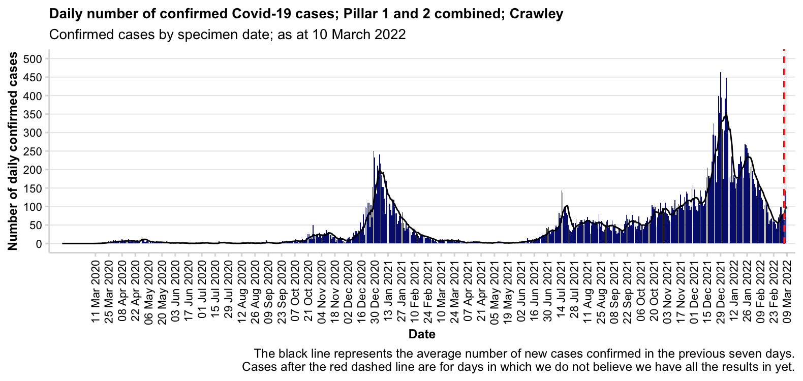
Source: https://coronavirus.data.gov.uk/
Slide 6

Slide 7
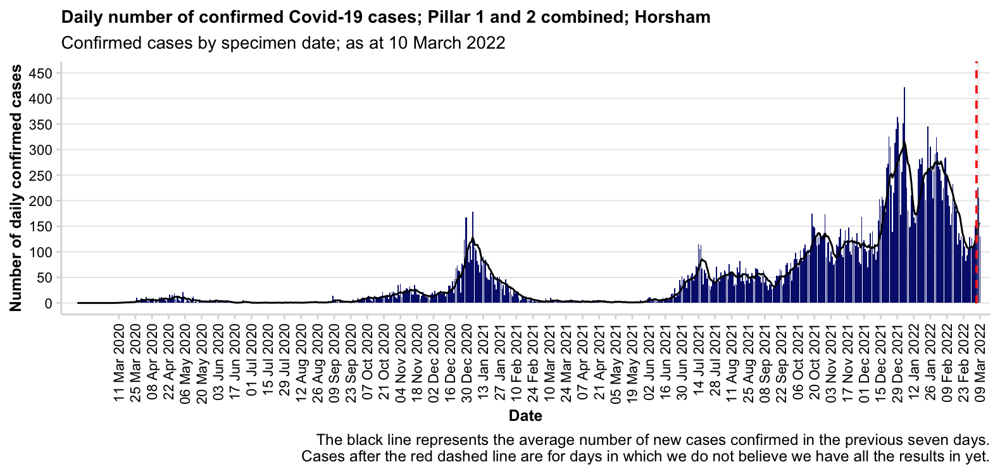
Source: https://coronavirus.data.gov.uk/
Slide 7

Slide 8

Source: https://coronavirus.data.gov.uk/
Slide 8

Slide 9
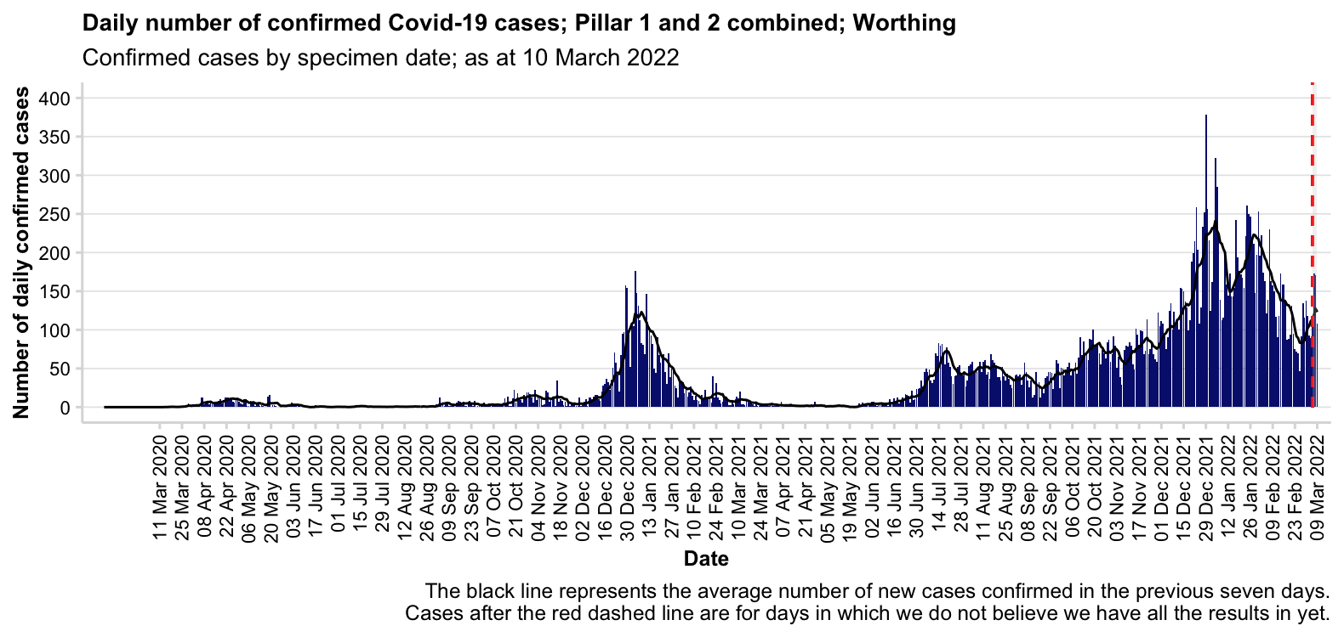
Source: https://coronavirus.data.gov.uk/
Slide 9

Slide 10
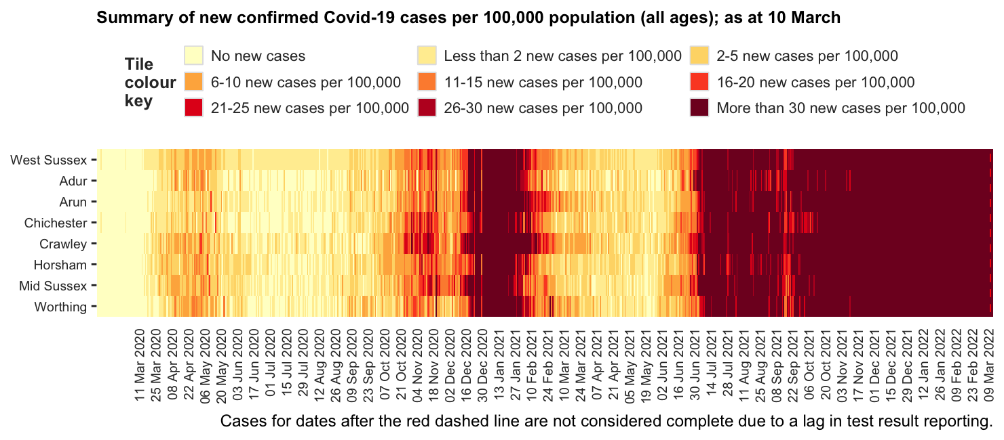
Source: https://coronavirus.data.gov.uk/
Slide 10

Slide 11
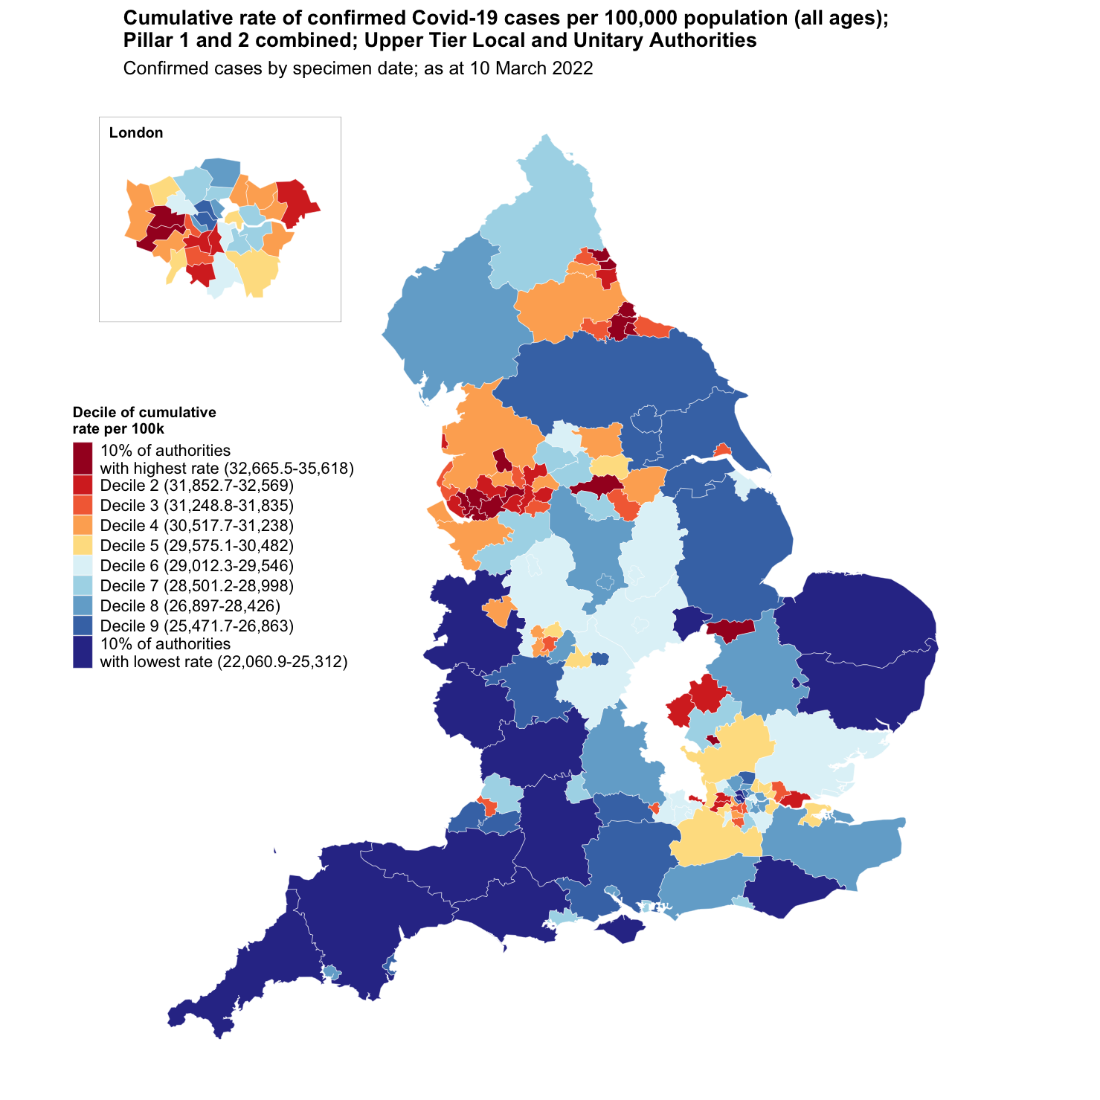
Upper Tier Local Authority cumulative cases as at 10 March
Name | Cumulative cases | Cumulative rate per 100,000 residents | Local Authority Rank (out of 149) where 1 = Highest Rate per 100,000 | Decile of cumulative rate per 100,000
West Sussex | 234,698 | 27,050.3 | 118th | Decile 8
England | 16,425,663 | 29,046.2 | - | -
South East region | 2,588,556 | 28,083.8 | - | -
What is a decile?
Every area in England is ranked from highest to lowest rate of confirmed COVID-19 cases per 100,000 population and then areas are divided 10 groups each representing 10% of the areas in England.
West Sussex is in the 8th decile.
Source: https://coronavirus.data.gov.uk/
Slide 11

Slide 12
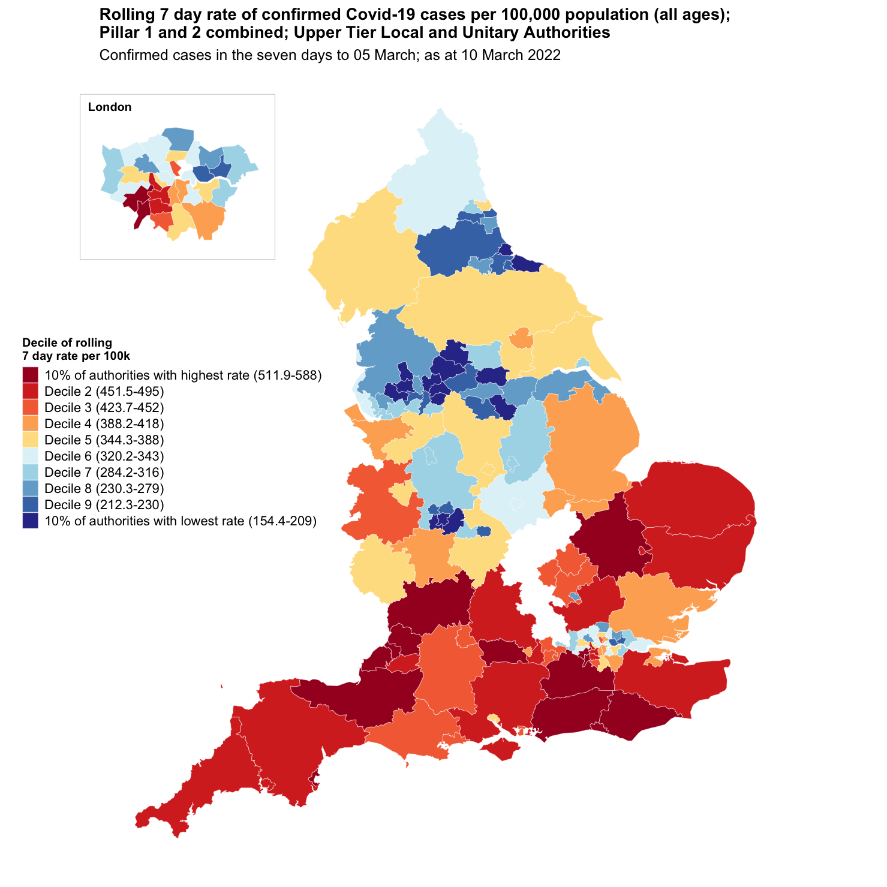
Upper Tier Local Authority rolling 7 day cases as at 10 March
Name | Rolling 7-day new cases | Rolling 7-day case rate per 100,000 | Local Authority Rank (out of 149) where 1 = Highest Rolling 7-day rate per 100,000 | Decile of rolling rate per 100,000
West Sussex | 4,712 | 543.1 | 8th | 10% of authorities with highest rate
England | 209,082 | 369.7 | - | -
South East region | 44,091 | 478.4 | - | -
What is a decile?
Every area in England is ranked from highest to lowest rate of confirmed COVID-19 cases per 100,000 population and then areas are divided 10 groups each representing 10% of the areas in England.
Note that the very recent days are excluded in the 7-day total as these are thought to be incomplete. As such, this data represents cases in the seven days to 05 March
Source: https://coronavirus.data.gov.uk/
Slide 12

Slide 13
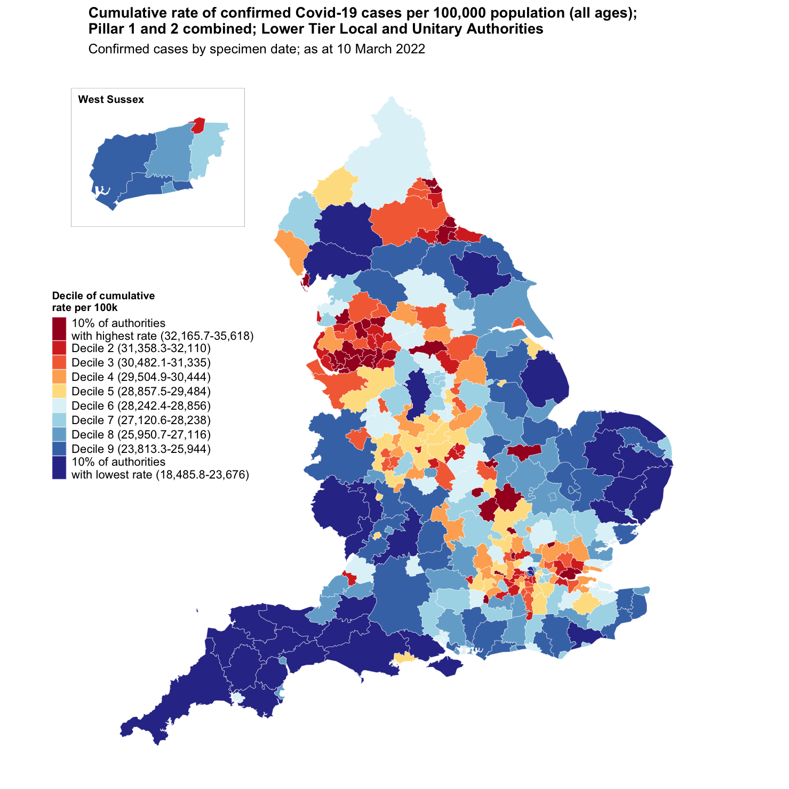
Lower Tier Local Authority cumulative cases as at 10 March
Name | Cumulative cases | Cumulative rate per 100,000 residents | Local Authority Rank (out of 315) where 1 = Highest Rate per 100,000 | Decile of cumulative rate per 100,000
Adur | 16,621 | 25,894.7 | 255th | Decile 9
Arun | 41,730 | 25,899.5 | 254th | Decile 9
Chichester | 29,873 | 24,585.2 | 278th | Decile 9
Crawley | 36,027 | 32,031.4 | 34th | Decile 2
Horsham | 37,932 | 26,074.8 | 248th | Decile 8
Mid Sussex | 42,810 | 28,138.2 | 194th | Decile 7
Worthing | 29,705 | 26,827.2 | 228th | Decile 8
West Sussex | 234,698 | 27,050.3 | - | -
South East region | 2,588,556 | 28,083.8 | - | -
England | 16,425,663 | 29,046.2 | - | -
What is a decile?
Every area in England is ranked from highest to lowest rate of confirmed COVID-19 cases per 100,000 population and then areas are divided 10 groups each representing 10% of the areas in England.
Source: https://coronavirus.data.gov.uk/
Slide 13

Slide 14
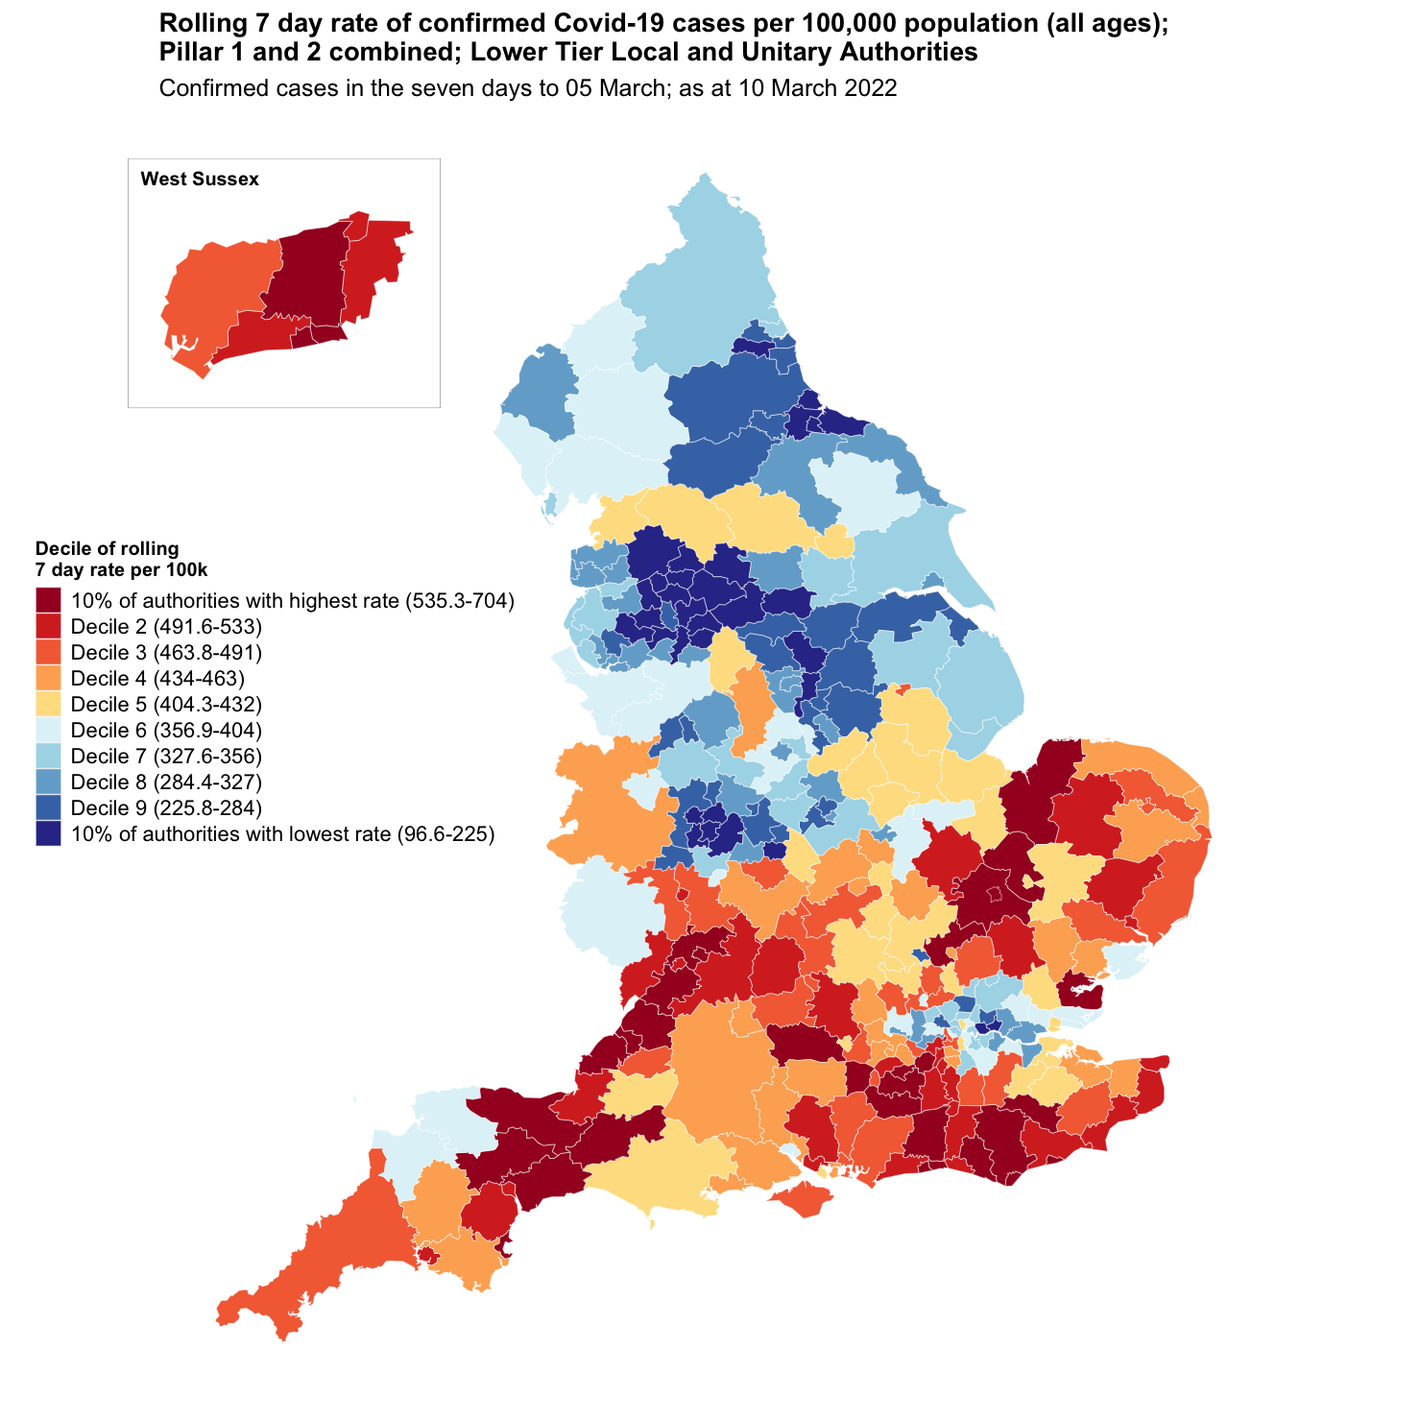
Lower Tier Local Authority rolling cases as at 10 March
Name | Rolling 7-day new cases | Rolling 7-day case rate per 100,000 | Local Authority Rank (out of 315) where 1 = Highest Rolling 7-day rate per 100,000 | Decile of rolling rate per 100,000
Adur | 384 | 598.3 | 9th | 10% of authorities with highest rate
Arun | 793 | 492.2 | 59th | Decile 2
Chichester | 565 | 465.0 | 91st | Decile 3
Crawley | 553 | 491.7 | 61st | Decile 2
Horsham | 851 | 585.0 | 13th | 10% of authorities with highest rate
Mid Sussex | 786 | 516.6 | 44th | Decile 2
Worthing | 780 | 704.4 | 1st | 10% of authorities with highest rate
West Sussex | 4,712 | 543.1 | - | -
England | 209,082 | 369.7 | - | -
South East region | 44,091 | 478.4 | - | -
What is a decile?
Every area in England is ranked from highest to lowest rate of confirmed COVID-19 cases per 100,000 population and then areas are divided 10 groups each representing 10% of the areas in England.
Note that the very recent days are excluded in the 7-day total as these are thought to be incomplete. As such, this data represents cases in the seven days to 05 March
Source: https://coronavirus.data.gov.uk/
Slide 14

Slide 15
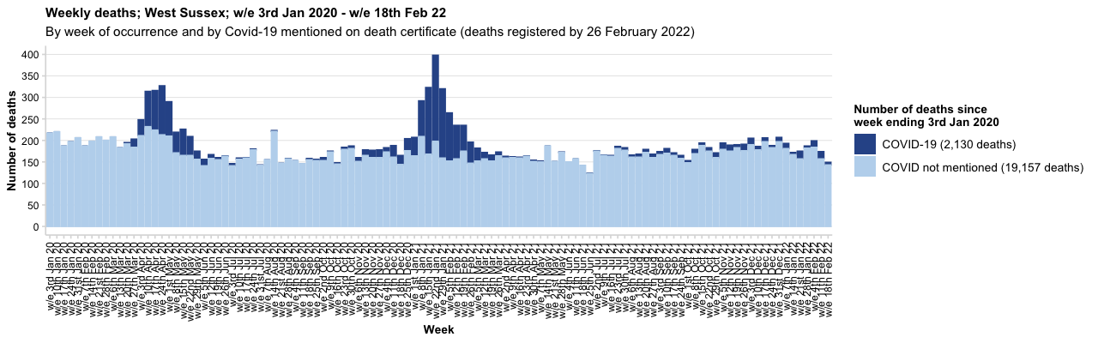
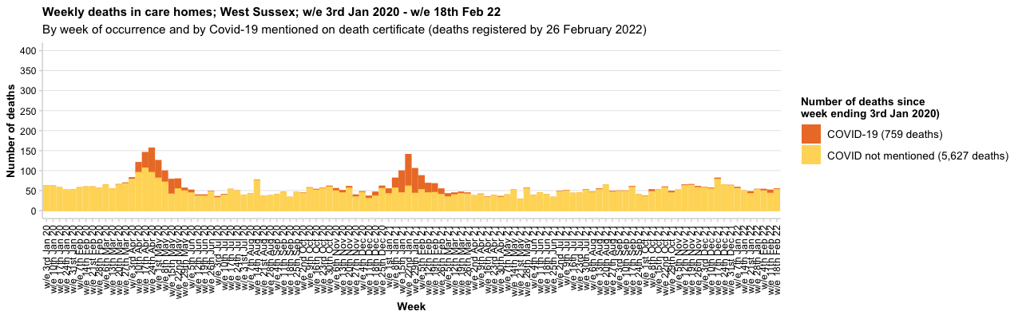
Source: Office for National Statistics
Slide 15

Slide 16
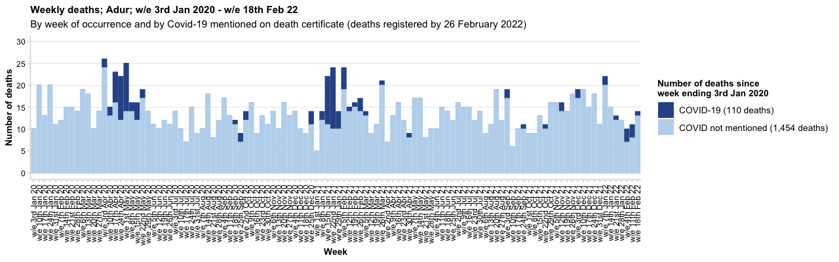
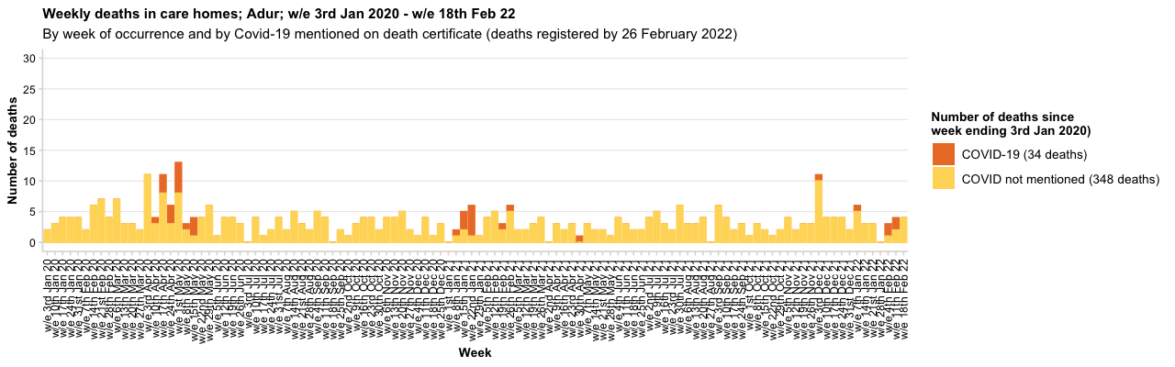
Source: Office for National Statistics
Slide 16

Slide 17
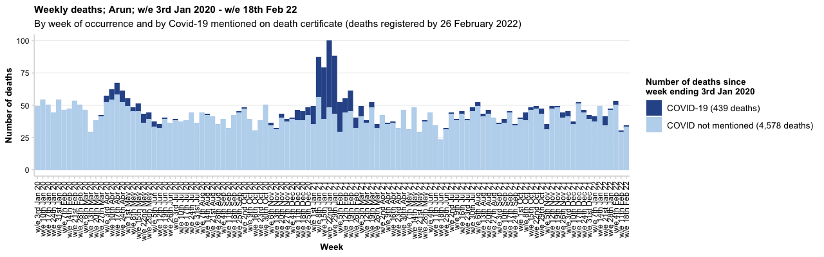
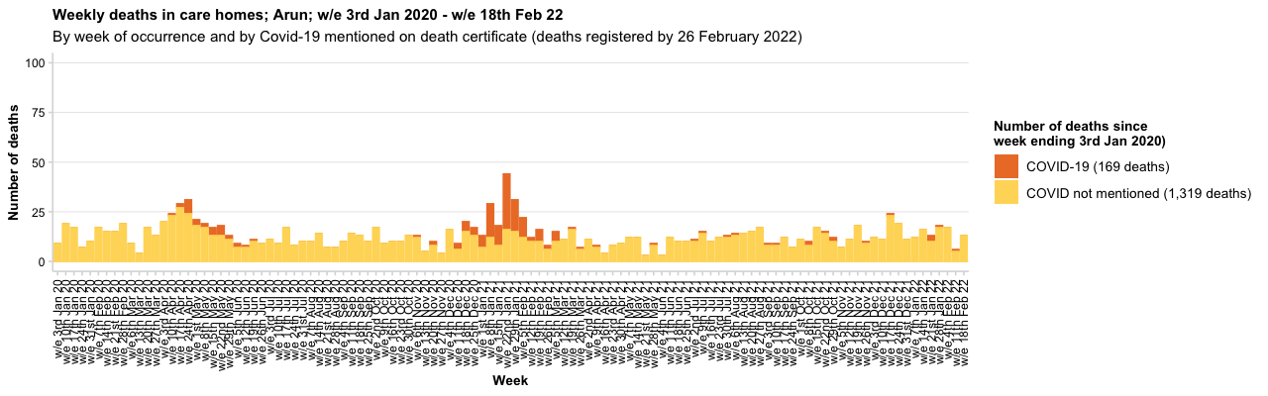
Source: Office for National Statistics
Slide 17

Slide 18
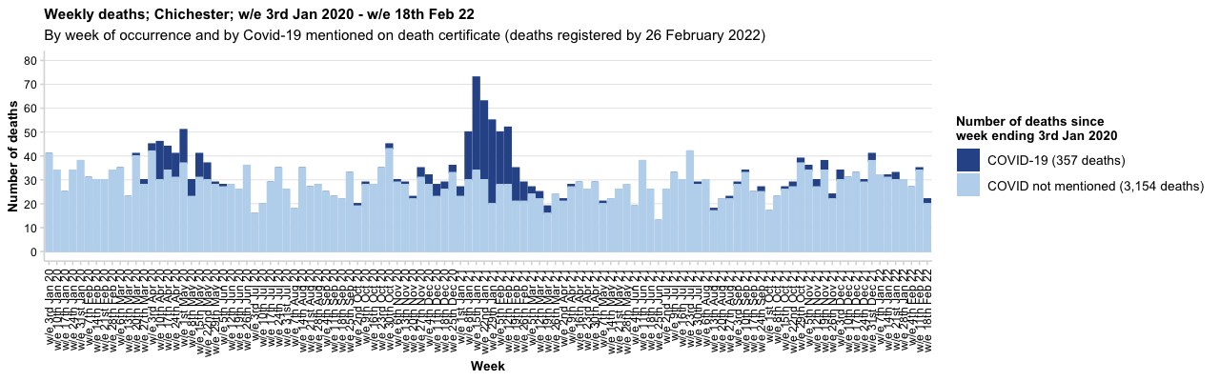
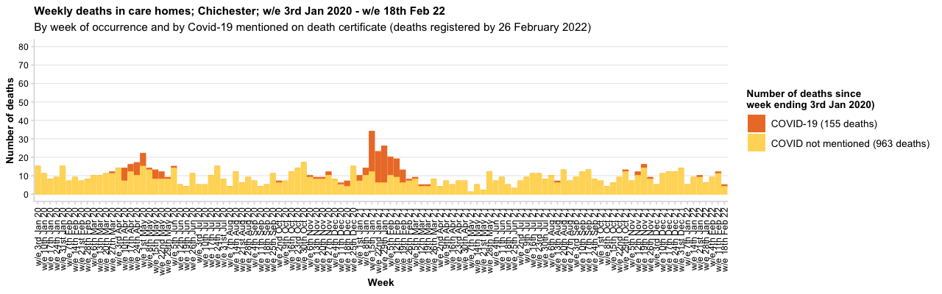
Source: Office for National Statistics
Slide 18

Slide 19
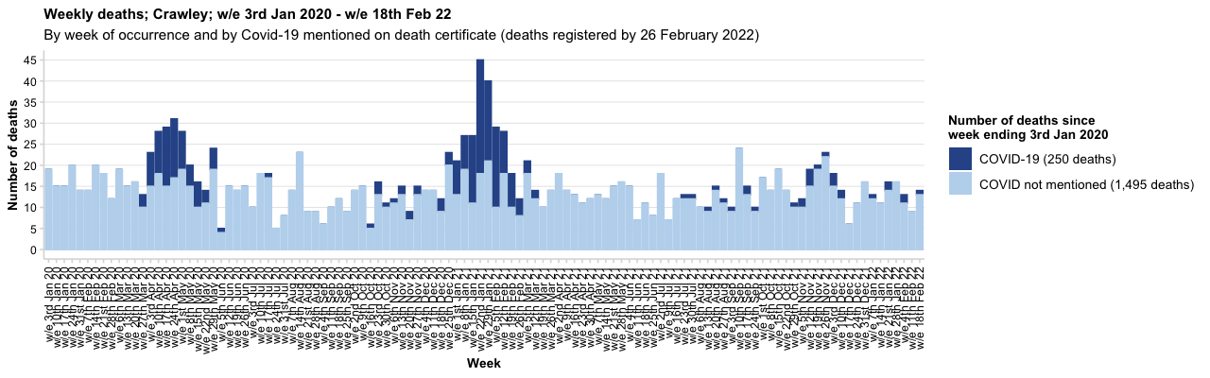
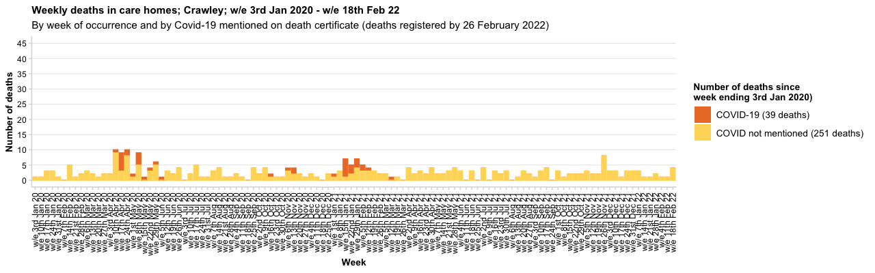
Source: Office for National Statistics
Slide 19

Slide 20
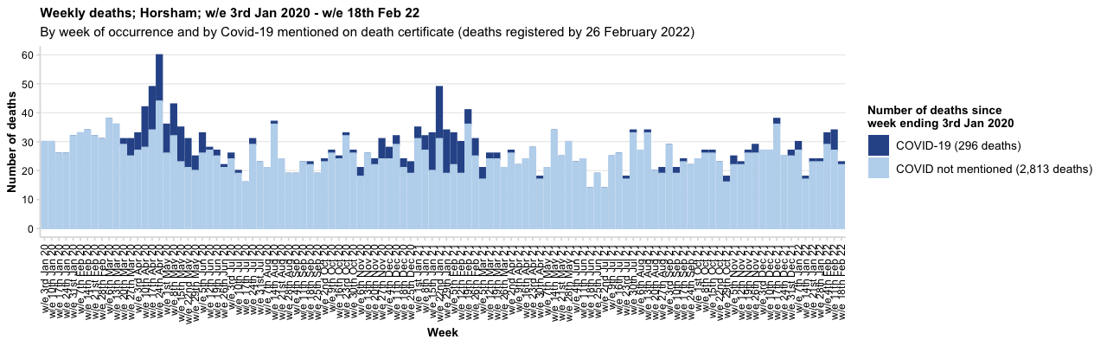
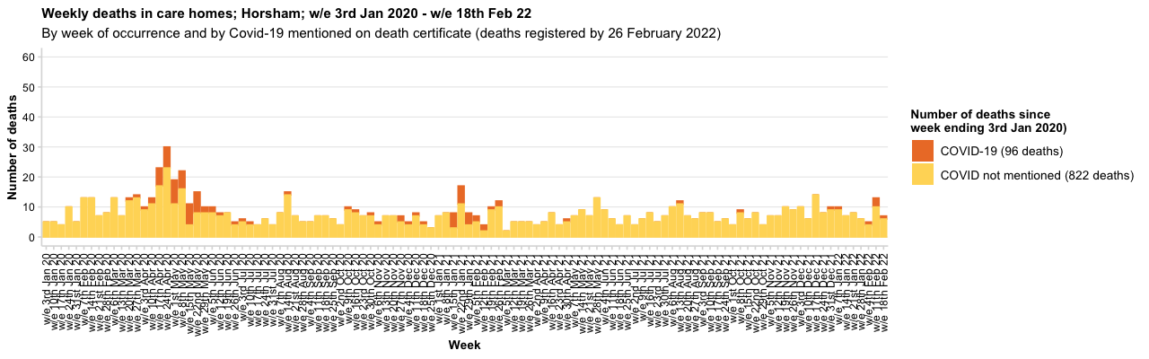
Source: Office for National Statistics
Slide 20

Slide 21
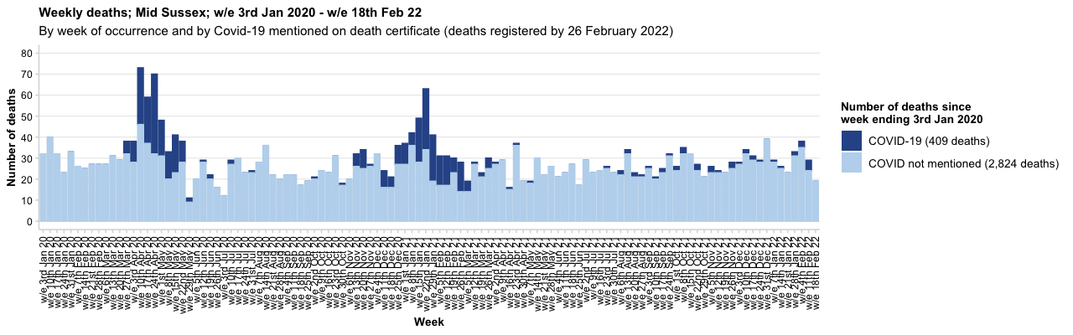
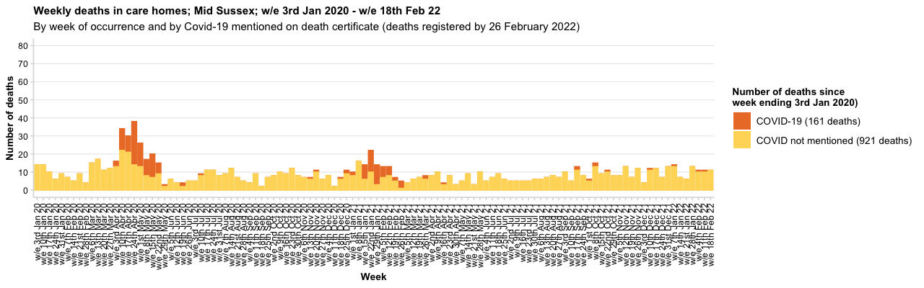
Source: Office for National Statistics
Slide 21

Slide 22
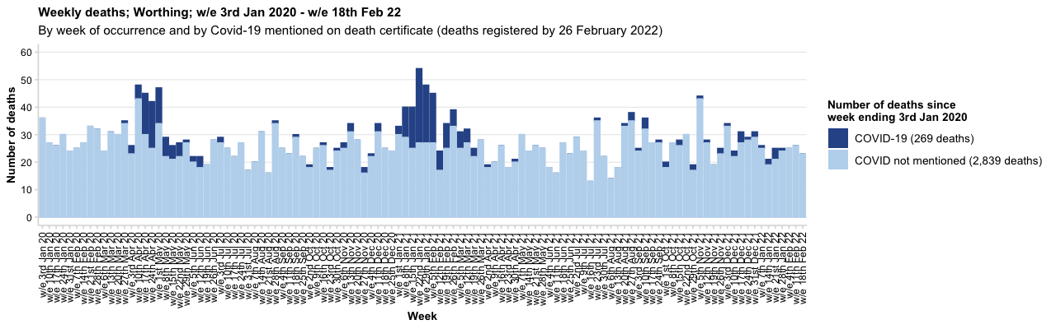
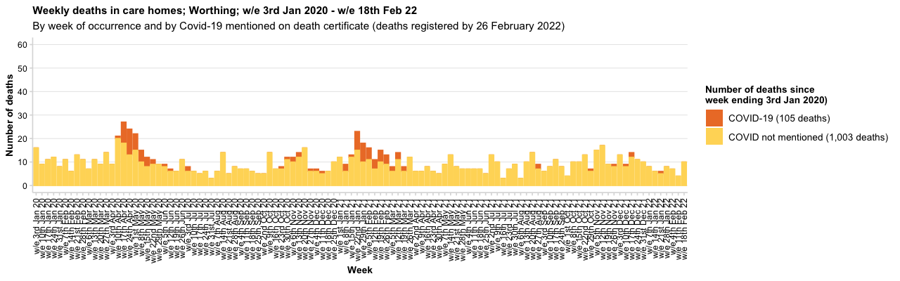
Source: Office for National Statistics
Slide 22

Slide 23
West Sussex Local Outbreak Control Plan – Links to data sources available to the public
West Sussex County Council
What |  | Link
Positive cases | Daily update on cases (shown as number of cases and also a rate per 100,000 residents) | https://coronavirus.data.gov.uk/
Positive cases and deaths | Using the cases and deaths tabs in the link - data are available at local authority level | https://coronavirus-staging.data.gov.uk/
NHS Pathways (callers to 111,999 and online 111 assessments) | Information on triages of 999 and 111 callers and completed online assessments which have received a potential coronavirus (COVID-19) final disposition (number and rate per 100,000 population). | https://digital.nhs.uk/dashboards/nhs-pathways
COVID-19: outbreaks in care homes | Weekly number and percentage of care homes reporting a suspected or confirmed outbreak of COVID-19 | Care home outbreaks
Hospital Data | Regional data are in the public domain – click on the healthcare tab for information on admissions, patients in hospital and patients on ventilation | https://coronavirus-staging.data.gov.uk/
Deaths in Hospitals | Daily data on deaths in specific NHS Trusts | https://www.england.nhs.uk/statistics/statistical-work-areas/covid-19-daily-deaths/
Deaths | Weekly data are published by the Office for National Statistics (on Tuesdays). | Weekly death data from ONS
Deaths in care homes notified to CQC | Deaths relating to care home residents, provides some additional detail not available on ONS weekly release | Link to CQC Notification Data
Deaths – additional analysis | The Office for National Statistics have released additional analysis – including analysis below local authority level | Deaths at a sub local authority level
Google Community Data | Community mobility at a local authority level and compare activity (in terms of visits to type of places) with baseline period (3 Jan – 6 Feb 2020). | https://www.google.com/covid19/mobility/
Sources can (and frequently do!) change, access as at time of pack date.

